Slide 1
Electronic Devices
Mid Term Lecture - 06
Faculty Name: Dr. Mohammad Alif Arman
Email : dr.alifarman@aiub.edu
Room: DN0526
Reference book:
Electronic Devices and Circuit Theory (Chapter-2)
Robert L. Boylestad and L. Nashelsky , (11th Edition)

Slide 2
Objectives
Become familiar with the analysis of and the range of applications for Zener diodes.

Slide 3
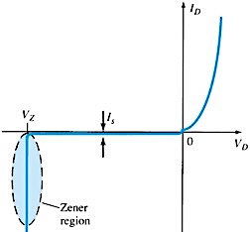
ZENER REGION
If the Diode is reverse biased and the voltage is increased, a point will be reached when the diode enters reverse breakdown and current will flow with a very rapid rate.
The direction of this current will be opposite to that of the positive voltage region.
The reverse bias potential that results in this dramatic change in characteristics is called the Zener Potential /Voltage and is given by the symbol V_{z}.
The reverse or Avalanche breakdown is often termed as Zener Breakdown (at very low levels).
The region where this sharp change in characteristics occur is known as Zener or Avalanche breakdown region and the current is termed as avalanche current.

Slide 4
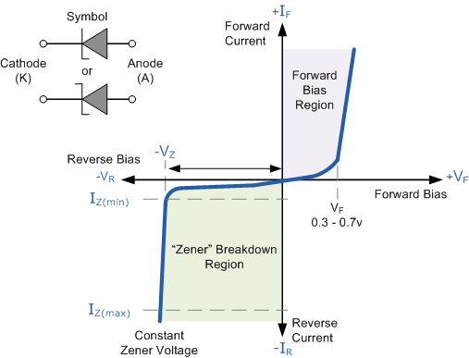
ZENER REGION
The maximum reverse-bias potential that can be applied before entering the Zener Region is called the peak inverse voltage (referred to simply as the PIV rating) or the peak reverse voltage (denoted by PRV rating).

Slide 5
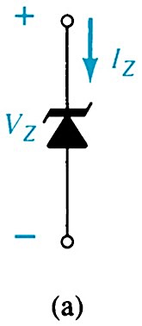
ZENER DIODE
Diodes that employ the dramatic characteristics of a p-n junction are called Zener Diodes.
Therefore, a Zener diode operates in reverse bias.
Common Zener Voltages: 1.8V to 200V.

Slide 6
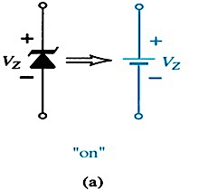
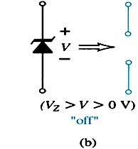
ZENER DIODE
The state of the diode must be determined followed by a substitution of the appropriate model and a determination of the unknown quantities of the network.
The off state is defined by a voltage less than V_{z} but greater than 0V. The Zener equivalent is the open circuit.

Slide 7
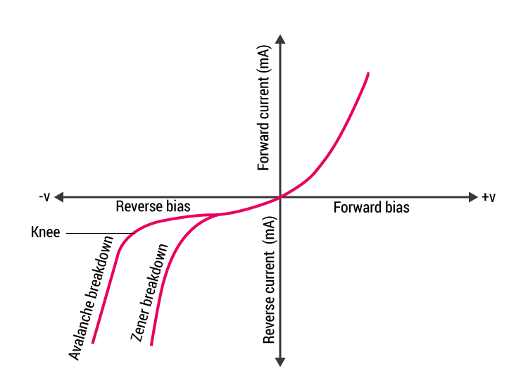
ZENER DIODE
The Zener diode is a heavily doped diode which, as a result of doping, has a very narrow depletion region. This allows the diode to be operated in the reverse biased region of the characteristic curve without damaging the PN junction.
“Zener Effect”: The area of Zener diode operation (<5V) where the Diode maintains a constant voltage output while operating reverse biased.
“Avalanche Effect”: >5V applied to the diode while reverse biased which tends to cause the diode to eventually breakdown due to heat generation within the lattice structure of the crystal.

Slide 8
ZENER DIODE
Because of its higher temperature and current capability, silicon is usually preferred in manufacture of Zener Diodes.
Zener Diodes provide a stable reference voltage for use in power supplies, voltmeter & other instruments, voltage regulators.

Slide 9
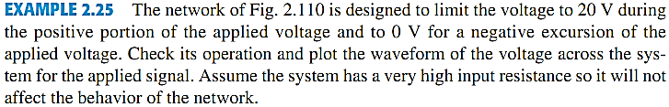
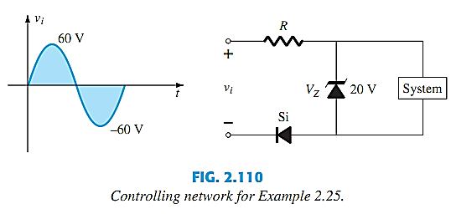
ZENER DIODE EXAMPLE

Slide 10
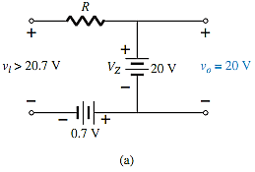
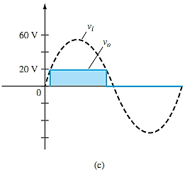
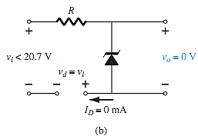
ZENER DIODE EXAMPLE

Slide 11
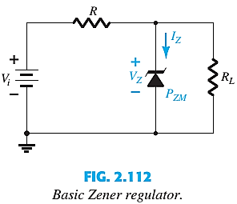

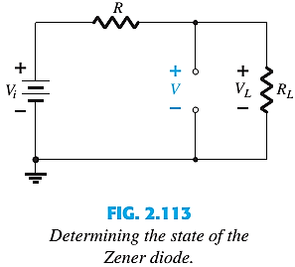
1st CONDITION: V_{i} AND R FIXED
The simplest of Zener diode regulator networks appears in Fig. 2.112 . The applied dc voltage is fixed, as is the load resistor. The analysis can fundamentally be broken down into two steps.
1. Determine the state of the Zener diode by removing it from the network and calculating the voltage across the resulting open circuit.
If V ≥ V_{Z}, the Zener diode is on, and the appropriate equivalent model can be substituted.
If V < V_{Z}, the diode is off, and the open-circuit equivalence is substituted.

Slide 12



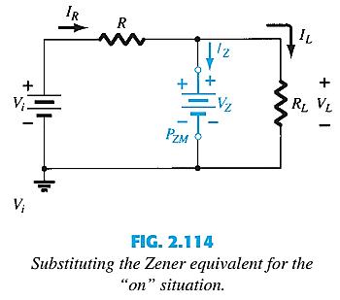

1st CONDITION: V_{i} AND R FIXED
2. Substitute the appropriate equivalent circuit and solve for the desired unknowns.
For the network of Fig. 2.112 , the “on” state will result in the equivalent network of Fig.2.114 . Since voltages across parallel elements must be the same, we find that
The power dissipated by the Zener diode is determined by
That must be less than the P_{ZM} specified for the device.

Slide 13

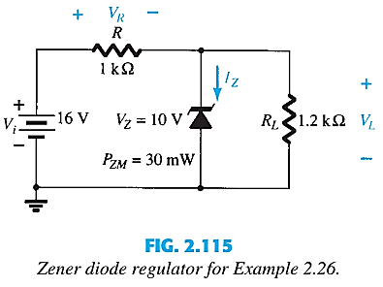
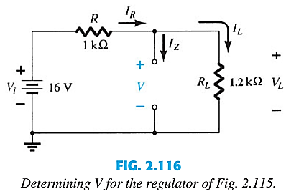

1st CONDITION: V_{i} AND R FIXED

Slide 14
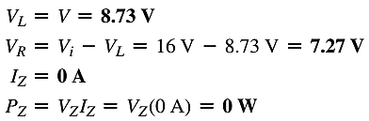
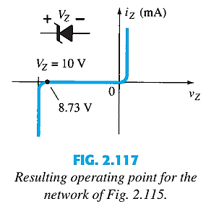

1st CONDITION: V_{i} AND R FIXED

Slide 15
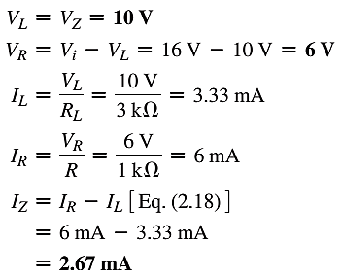
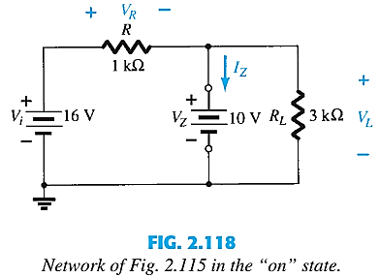

1st CONDITION: V_{i} AND R FIXED

Slide 16



2nd CONDITION: FIXED V_{i}, VARIABLE R_{L}
Due to the offset voltage V_{z}, there is a specific range of resistor values (and therefore load current) which will ensure that the Zener diode is in the on state.
Too small R_{L} → V_{L} < V_{z} → Zener diode will be in the off state.
To determine the min R_{L} that will turn the Zener diode on :
Any load resistance value greater than the R_{L} min will ensure that the Zener diode is in the on state and the diode can be replaced by its V_{z} source equivalent.
The max I_{L}

Slide 17





2nd CONDITION: FIXED V_{i}, VARIABLE R_{L}
Once the diode is in the on state, the voltage across R remains fixed at:
I_{z} is limited to I_{ZM} as provided on the data sheet, it does affect the range of R_{L} and therefore I_{L}.
The maximum load resistance
See Example 2.27.

Slide 18





3rd CONDITION: FIXED R_{L}, VARIABLE V_{i}
For fixed values of R_{L}, the voltage V_{i} must be sufficiently large to turn the Zener diode on. The min turn-on voltage V_{i}=V_{i min} :
The max value of V_{i} is limited by the max Zener current I_{ZM}.
Since I_{L} is fixed at V_{Z}/R_{L} and I_{ZM} is the max value of I_{Z}, the max V_{i} is defined by:

Slide 19
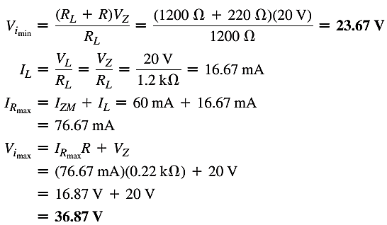
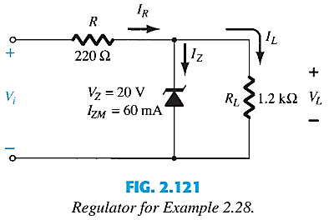
3rd CONDITION: FIXED R_{L}, VARIABLE V_{i}

Slide 20
Thank You

